Slide 1

Class Session Check List
Everyone:
Sign into our Zoom meeting through our integrated Blackboard/Zoom link
Make sure that you can hear the conversation, see shared desktops, and view group chat topics
You will need a headset with a microphone to be able to effectively listen and speak
You will need to be able to share your computer screen
Thank you if you choose to leave your camera on to help make our class more interactive
In person participants also:
Make sure that your microphone and speakers are muted/off so that we don’t get an echo
Sit in a good spot near the classroom ceiling microphones if possible

Slide 2
Class Session Check List
Review that recordings are:
Opportunistic
Automatically available within Blackboard/Zoom
… Now make sure that the classroom microphone, speakers, and camera are being used in Zoom, move to the next slide, AND verify that recording is started.
… Also make sure that slides are visible to attendees

Slide 3
Agenda:
Prework and Announcements
Scrum Team Review on Requirements
Software Development Models and Requirements
Discussion Board 3
Prework for Next Class
Discussion & Questions welcome at any time but please be present with no phones or email during our time together

Slide 4
Requirement, Requirements, Requirements, and More Requirements!!!
Notes:
Critical Path… Light Weight long-term planning

Slide 5
Prework
Complete through activity 8 prior to next class
Be prepared for a scrum team chapter 7 on Requirements

Slide 6
Scrum Team Review – Chapter 7 Requirements
Assign presenter
Team reviews key topics including percent of chapter and percent of lecture
Team sits back, relaxes, and acknowledges the bravery and dedication of the presenter

Slide 7
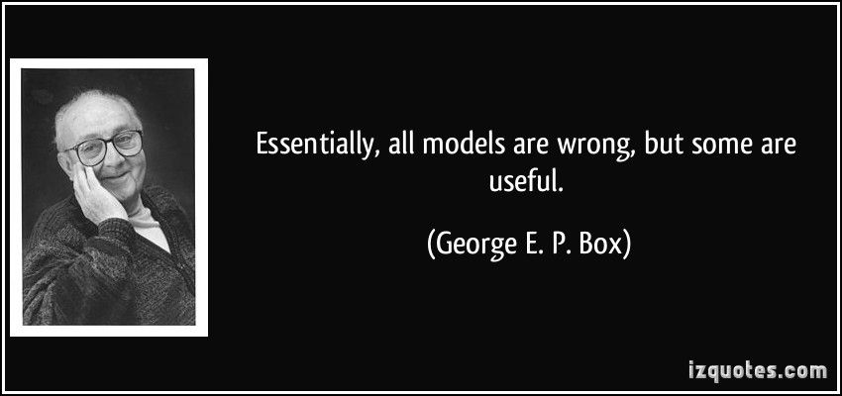
Models

Slide 8
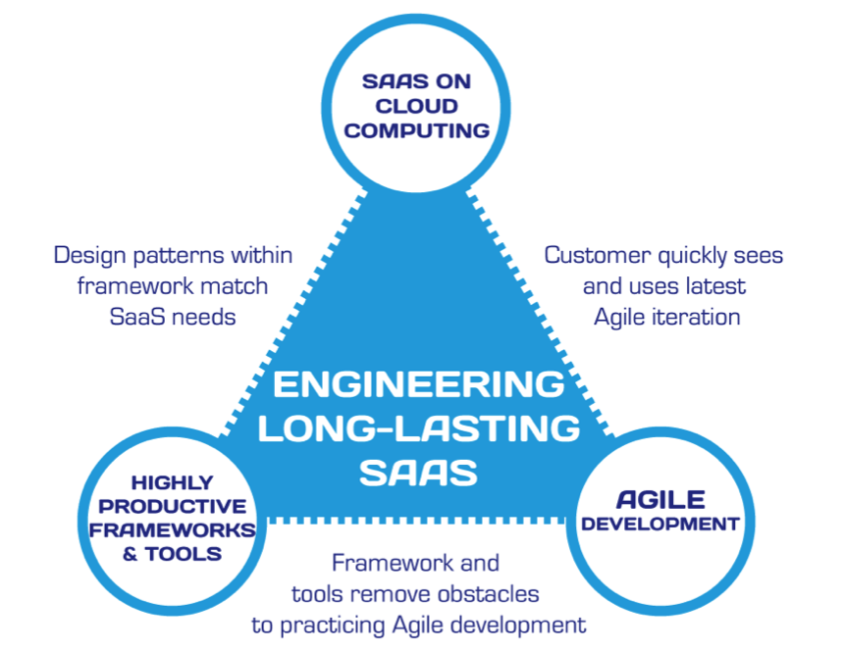
Hosting Technology: Cloud & Software as a Service (SaaS)…
People: Organizations, Domain Knowledge, Customers, Business Process…
The
Virtuous Triangle
Process: Agile, Requirements, Project Management, Prioritization, Portfolio Management, Metrics…
Productivity Technology: Configuration Management, Source Code Management, Automated Testing…

Slide 9
The Righteous Triangle of Software Development
People & Organizations
Technology & Tools
Process & Roles

Slide 10
Waterfall vs Iterative vs Agile Requirements
 | Waterfall | Iterative | Agile
References | United States Department of Defense: DOD-STD-2167A (1985) | Rational Unified Process (RUP) Open Unified Process | Scrum Kanban Scaled Agile Framework (SAFe)
Priorities | Planning and predictability | Architecture, modeling, and efficiency through early detection & fixing of issues (verification) | Responsiveness to feedback, efficiency through engineering practices, early detection & fixing of issues, and validation
Principles | Execute phases sequentially: Requirements Analysis Design Coding Testing and Operations Define and commit to Scope, Cost, and Timeline “early” Implement strict Change Control | Manage requirements Develop and test iteratively Use components Model visually Verify quality Control changes | Capture lightweight near term requirements Allow requirements to evolve but maintain fixed timelines Develop, test, deploy, and release iteratively Empower teams Apply engineering practices and systems thinking Integrate early user feedback into remaining plan Maintain a collaborative approach between all stakeholders
Notes:
The views on testing and change management have changed dramatically as organizations have moved from Waterfall to Iterative to Agile development lifecycles.
Successful Agile (and Iterative) Development REQUIRES better application design, development techniques, and testing practices.
Testing and lack of defects are not the end goal. A higher quality more usable more cost-effective product is the goal.
Requirements:
Waterfall:
Full project requirements upfront
Inconsistent industry capture techniques
Tend to be verbose requirements with formal signoff
Change requests needed
Estimation bottom up detailed estimates sometimes function points
Iterative:
Mostly upfront

Slide 11
Requirements – Waterfall
When working in a Waterfall SDLC Requirements are generally:
Captured up front (before any design or development)
Documented in a variety of formats
Verbose
Estimated in detail using bottom-up estimating techniques (sometime Function Points)
Risk Analysis & Mitigation
Signed off on
Managed with change requests
Notes:
Grace period until Monday morning a 6am CT

Slide 12
Requirements – Iterative (RUP)
When working in an Iterative (RUP) SDLC Requirements are generally:
Captured primarily up front but updated during design
Documented in Use Cases
Moderately verbose
Estimated using Use Case points
Signed off on with an understanding that minor changes are likely
Managed with change requests
Notes:
Grace period until Monday morning a 6am CT

Slide 13
Recall Scaled Agile Framework is an Agile Model
Notes:
Critical Path… Light Weight long-term planning

Slide 14
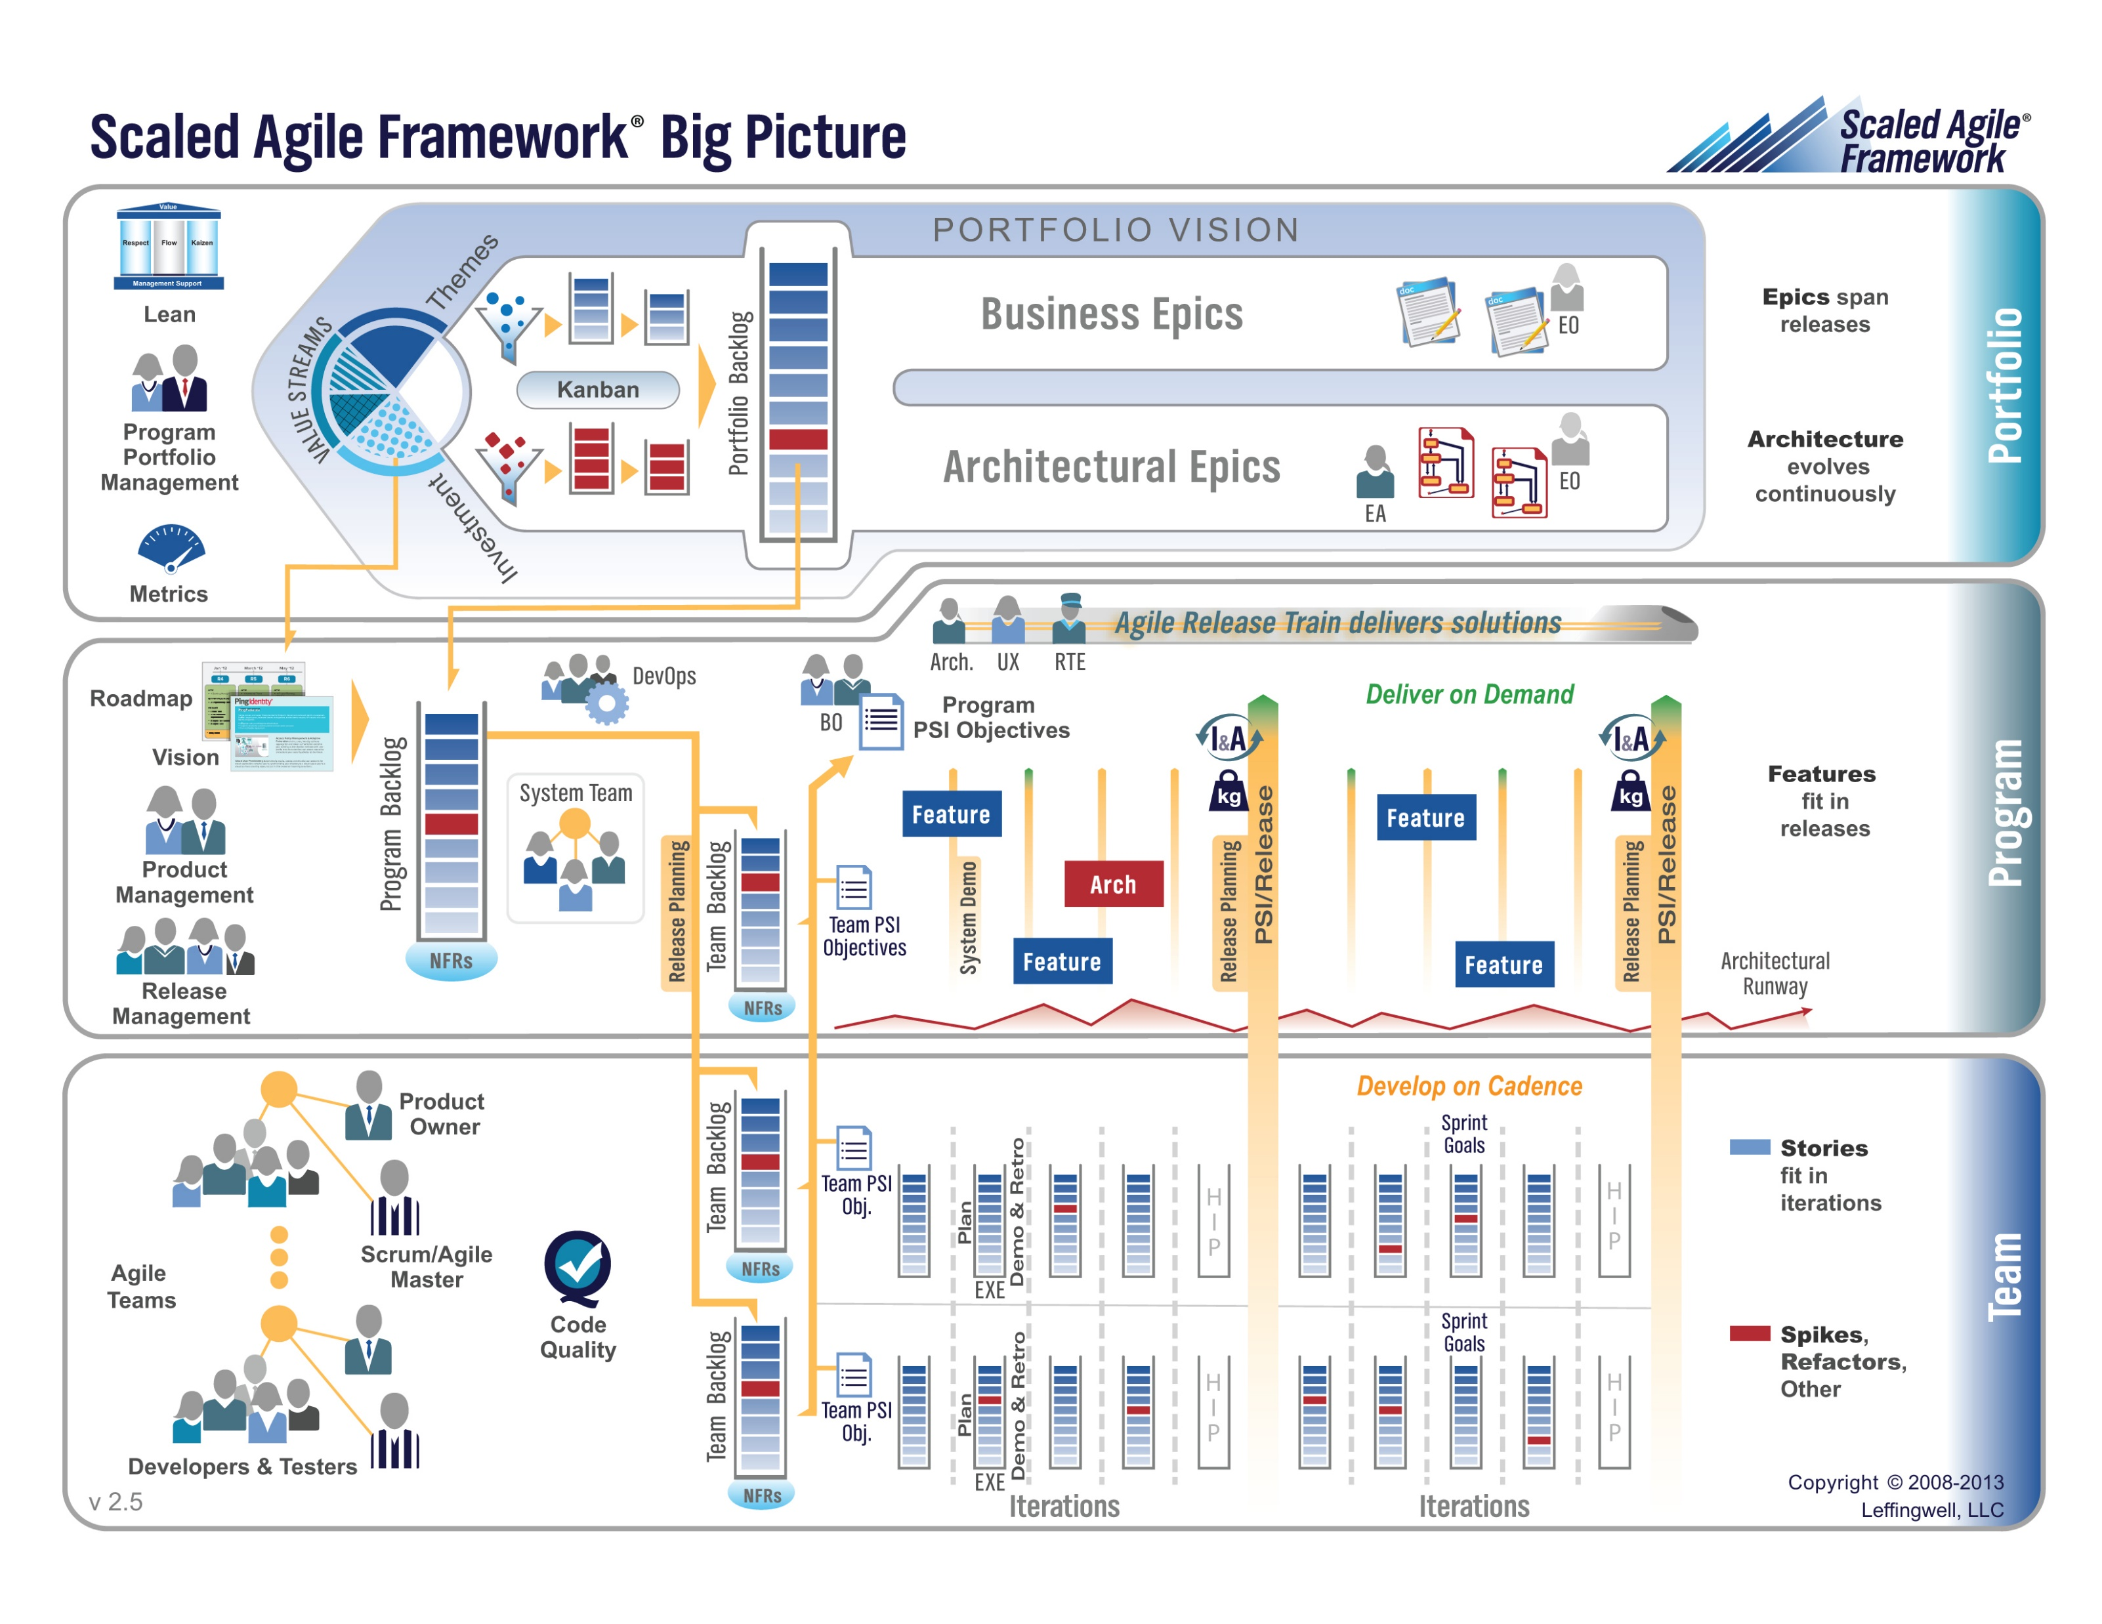

Slide 15
Requirements – Agile (Scrum)
When working in an Agile (Scrum) SDLC Requirements are generally:
Captured before each sprint
Documented using Stories (light weight)
In Scaled Agile Epics & Features are also used
Only detailed as needed
Estimated using Story Points (very light weight)
Immutable for current sprint
Change is encouraged for future sprints
Notes:
Final Topics:
SMART: Specific, Measurable, Achievable, Relevant, and Time-boxed
Be very careful attempting to measure productivity across teams
Story Points vs Use Case Points vs Function Points

Slide 16
Plan-and-Document Requirement Relevance to Agile
Notes:
Project Plans, Tracking, Managing

Slide 17
Multi-Domain Integration & Complex Dependencies
Notes:
Critical Path… Light Weight long-term planning

Slide 18
Multi-Domain Examples
Most Agile system development is part of a larger initiative that includes multiple domains. Many of these larger initiatives are unable or unwilling to fully adopt Agile methodologies.
Examples include:
Implementing a new aircraft model
Building a new car factory
Updating a new car model or a new model of agricultural harvester
Executing portfolio management and annual budgeting within an organization
Migrating to a new purchased accounting system (buy vs build)
Agile initiatives need to be able to effectively integrate which often requires adopting some Plan & Document Project Management practices.

Slide 19
Complex Dependencies
Agile processes intentionally do not look for long term dependencies. There are times when intentionally managing and monitoring at least a subset of these dependencies is necessary.
Examples:
Implementing user preferences is dependent on securely creating a website in the Google cloud
Securely creating a web page in the Google cloud is dependent on custom authentication
Custom authentication is dependent on Microsoft Office user authentication
Microsoft Office authentication likely requires hosting a web service in Azure
Pure Agile may not allow us to understand that we need to start on item 4 four sprints before we expect to have item 1 implemented.

Slide 20
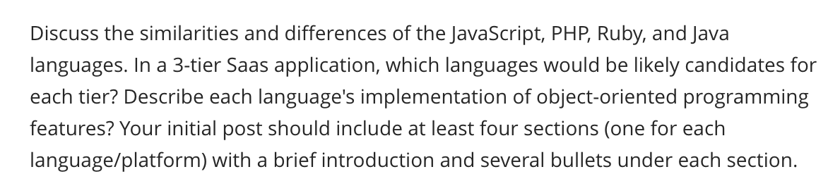
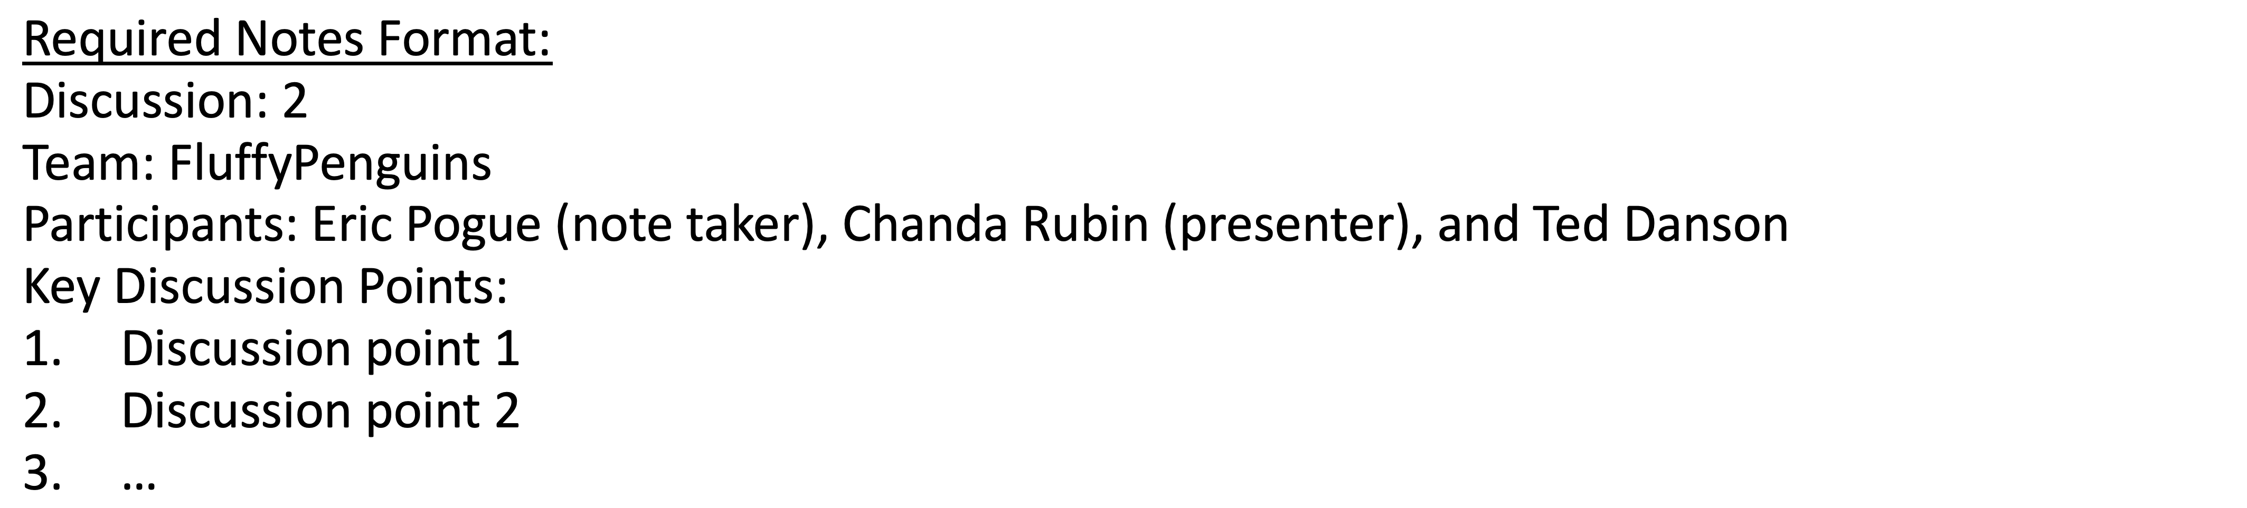
Scrum Team Discussion Board 3
Assign note taker and presenter roles to team members
Review and discuss the discussion topic for this sprint for approximately 10 minutes
Note taker takes notes and presenter prepares a report out summary
Note taker share notes with all participating team members
Each team member pastes and submits exact copy of the notes into their discussion board
Sit back, relax, and tell the note taker and presenter what I wonderful job the did
Notes:
Seating chart and attendance tracker (virtual and in person)

Slide 21
Question & Answers

Slide 22
Prework For Next Class
Complete through activity 12 prior to next class
Be prepared for Programming Together with NodeJS and Azure

Slide 23
End of Session

Slide 24
Backup Slides

Slide 25
Friendly Conversation Topic

Slide 26
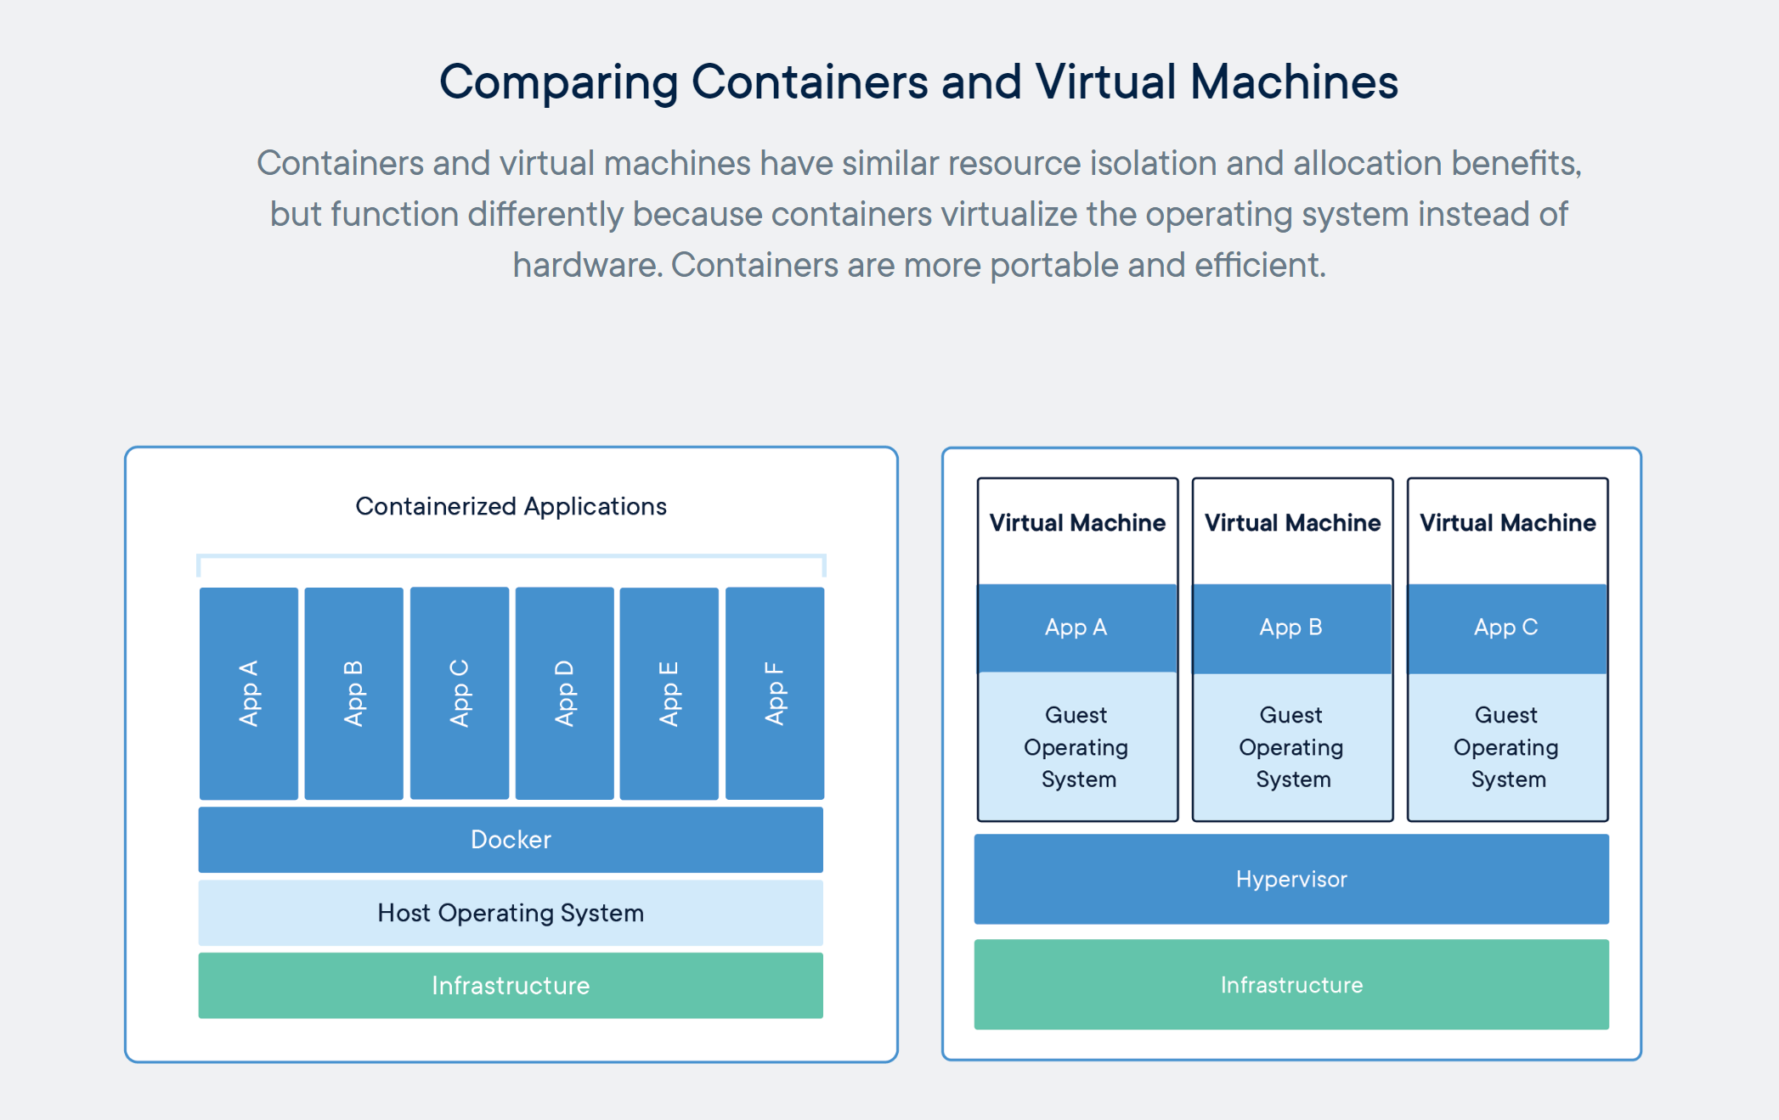
Containers & Docker [link]

Slide 27
Kubernetes & Swarm [link]

Slide 28
Software Testing
Notes:
Project Plans, Tracking, Managing

Slide 29
Recall Test-driven Development (TDD)
Test-driven development (TDD) is a software development process that relies on the repetition of a very short development cycle: requirements are turned into very specific test cases, then the code is improved so that the tests pass. This is opposed to software development that allows code to be added that is not proven to meet requirements.
American software engineer Kent Beck, who is credited with having developed or "rediscovered"^{[1]} the technique, stated in 2003 that TDD encourages simple designs and inspires confidence.^{[2]}
Test-driven development is related to the test-first programming concepts of extreme programming, begun in 1999,^{[3]} but more recently has created more general interest in its own right.^{[4]}
Programmers also apply the concept to improving and debugging legacy code developed with older techniques.^{[5]}
From Wikipedia, the free encyclopedia
Notes:
What is the term that Jeremy used for doing it in the place?

Slide 30
The Righteous Triangle of Software Development
People & Organizations
Technology & Tools
Process & Roles

Slide 31
Software Testing Overview
Software Testing [link] is important because, if done right, it can help us find and fix problems earlier and make our system delivery process less immobile, rigid, and fragile.
As future Software Engineers , we are going to:
Understand testing within the various Software Development Lifecycles
Understand testing terminology
Know how to develop applications that are easier to test
Understand Unit Testing and Automated Testing
Notes:
Never underestimate the value of good design and implementation (for testability, encapsulation, etc.) on the economics of testing. You can’t afford to test in quality!
Developers are responsible for product quality. Tester should be able to minimize that chance that a defect makes it to production.
We test to find defects and/or to validate that we have not introduced new defects.
Defects are exponentially more expensive to fix the longer the exist.
Performance issues are often the most difficult and expensive defects to fix. They are often not found until the application if running under production load… which is often only when it is in production.
Unit - $200
Integration - $600
User Acceptance - $6,000
Production - $100,000+
The permutations of modern software features, data, tools, environments, etc. quickly becomes unmanageable. Testability needs to be goal of nearly all non-trivial applications.
Dave Cutler of Windows NT fame had a quote. I wish I could remember the exact words, but it went something like, “I hate having testers because they give developers the false hope that someone else can save them from their sins.”

Slide 32
Waterfall vs Iterative vs Agile Requirements
 | Waterfall | Iterative | Agile
References | United States Department of Defense: DOD-STD-2167A (1985) | Rational Unified Process (RUP) Open Unified Process | Scrum Kanban Scaled Agile Framework (SAFe)
Priorities | Planning and predictability | Architecture, modeling, and efficiency through early detection & fixing of issues (verification) | Responsiveness to feedback, efficiency through engineering practices, early detection & fixing of issues, and validation
Principles | Execute phases sequentially: Requirements Analysis Design Coding Testing and Operations Define and commit to Scope, Cost, and Timeline “early” Implement strict Change Control | Manage requirements Develop and test iteratively Use components Model visually Verify quality Control changes | Capture lightweight near term requirements Allow requirements to evolve but maintain fixed timelines Develop, test, deploy, and release iteratively Empower teams Apply engineering practices and systems thinking Integrate early user feedback into remaining plan Maintain a collaborative approach between all stakeholders
Notes:
The views on testing and change management have changed dramatically as organizations have moved from Waterfall to Iterative to Agile development lifecycles.
Successful Agile (and Iterative) Development REQUIRES better application design, development techniques, and testing practices.
Testing and lack of defects are not the end goal. A higher quality more usable more cost-effective product is the goal.
Requirements:
Waterfall:
Full project requirements upfront
Inconsistent industry capture techniques
Tend to be verbose requirements with formal signoff
Change requests needed
Estimation bottom up detailed estimates sometimes function points
Iterative:
Mostly upfront

Slide 33
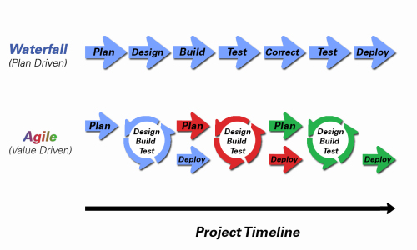
Object-Oriented Programming within Various Development Methodologies
Notes:
Development Methodology and Software Development Lifecycle (SDLC) are often used interchangeably.
The Iterative development methodology is not depicted here as even the mainstays and inventors of the Iterative development methodology seem to be moving toward agile. Plus as Waterfall “holdouts” move, they seem to be moving directly toward Agile. Can you start to see my biases?
Development Methodologies (SDLCs) are a future Bonus Topic. There are several optional slides t the end of this deck. Let me know if you would like to have a more formal overview of the topic as part of this class. I have a passion in this area.
Object oriented-programming concepts/practices evolve and reprioritize depending on the development methodology.
For example, in Waterfall (as well as in Iterative) object-oriented design often play a critical role in the (big upfront) design activities. UML diagrams and project artifacts are often important to the overall project success. (opinion) Practical reality has been that these design artifacts often do not reflect the actual implementation and are rarely maintained or updated.
The Agile practitioners do not reject these design artifacts. However, the focus on shorter time horizons, evolving architecture, and working code changes the value proposition for object-oriented practices to more focus on the build, test, enhance activities.

Slide 34
Software Testing “Truths”
Never underestimate the value of good design and implementation (for testability, encapsulation, etc.) on the economics of testing… You can’t afford to test in quality!
Defects are exponentially more expensive to fix the longer the exist.
Unit - $200
Integration - $600
User Acceptance - $6,000
Production - $100,000+
Performance issues are often the most difficult and expensive defects to fix. They are often not found until the application if running under production load… which is often only when it is in production.
The permutations of modern software features, data, tools, environments, etc. quickly becomes unmanageable. Testability needs to be goal of nearly all non-trivial applications.

Slide 35
Software Testing “Truths” (continued)
Developers need to be responsible for product quality. Tester should be able to minimize that chance that a defect makes it to production.
Dave Cutler of Windows NT fame had a quote. I wish I could remember the exact words, but it went something like, “I hate having testers because they give developers the false hope that someone else can save them from their sins.”

Slide 36
Testing Terms
Important testing terms include:
Unit Testing: developer testing their own code
Integration Testing: development team testing their full code
System Testing: multiple development teams testing a full system or systems
Performance Testing: testing performance at the Unit, Integration, and/or System level
Manual Testing: a person using the application often running test scenarios
Automated Testing: a group of automated tests that run on the application in the Unit, Integration, System, or Performance testing areas
UI Automated Testing attempts to exercise the application be reproducing user events (key & mouse events)
API Automated Testing occurs at the function/method API level (JUnit for example)

Slide 37
Testing Terms
Important testing terms (continued):
Verification: does the application perform as expected
Validation: does the application provide the business benefit that was expected
Behavioral Testing: verifying that the correct functions were called with the correct parameters
State Testing: focuses on the results of those calls

Slide 38
Automated Testing
Unit testing can be done in two ways − manual testing and automated testing.
Automated testing has become a more important part of effective software testing. The pros of Automated Testing include:
Repeatable tests that are quick to run and can support Iterative and Agile development
Very effective in validating environments and doing “smoke tests” to make sure a new build meets a minimal set of requirements
Supports Performance Testing very effectively
Very inexpensive and quick to repeat testing and validate fixes
Various implications include UI, API, and Unit automation tests… each has a very different set of pros and cons
Notes:
False positives versus valid defects found.
Manual Testing and Automated Testing can be supportive of each other.

Slide 39
Automated Testing
Unit testing can be done in two ways − manual testing and automated testing.
Some of the benefits of Automated Testing have been oversold. Some of the challenges include:
Developers rarely can come up with scenarios in scripts that they would not already have tested in their normal unit testing… they often don’t know what they don’t know
UI focused Automated Testing (key & mouse events) are often challenging and create/maintain a great number of false-positives
API Level Automated Testing (i.e. REST) scripts are often more useful and easier to maintain
Environmental verification, API, and finally UI Automated testing is generally the best order to show value quickly with Automated Testing
Automated Testing investment is often not prioritized or tracked so it is difficult to know its effectiveness
Scripts can be expensive to develop and maintain
Notes:
False positives versus valid defects found.
Manual Testing and Automated Testing can be supportive of each other.

Slide 40
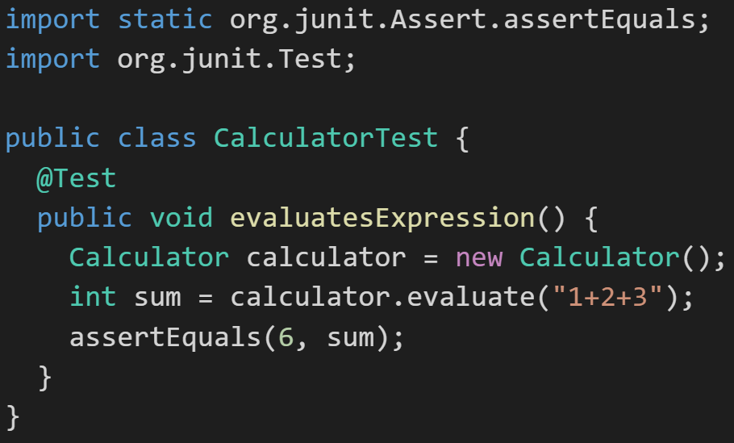
Automated Unit Testing Example: JUnit
Unit testing can be done in two ways − manual testing and automated testing.
JUnit [link] is a Automated Testing framework focused on developing and running Unit test for Java applications. JUnit:
Is a Java opensource extension
Provides annotations to identify test methods.
Provides assertions for testing expected results.
Provides test runners for running tests.
JUnit tests allow you to write codes faster, which increases quality.
JUnit is elegantly simple. It is less complex and takes less time.
JUnit tests can be run automatically and they check their own results and provide immediate feedback. There's no need to manually comb through a report of test results
Notes:
@Test
identifies the method as a test method (remember, method and function are synonyms)
@Test(expected = Exception.class)
fails if the method does not throw the named exception
@Test(timeout=100)
fails if the method takes longer than 100 milliseconds
@Before
public void method()
This method is executed before each test. It is used to prepare the test environment.
@After
public void method()
This method is executed after each test. It is used to clean up the test environment, including cleaning up expensive memory structures.
@BeforeClass
public static void method()
This method is executed once, before any test is done. It is used to do time-intensive tasks before any test is done.

Slide 41
Final Thoughts
Notes:
Project Plans, Tracking, Managing

Slide 42
Plan-and-Document Project Management
Notes:
Project Plans, Tracking, Managing

Slide 43
Multi-Domain Integration & Complex Dependencies
Notes:
Critical Path… Light Weight long-term planning

Slide 44
The Righteous Triangle of Software Development
People & Organizations
Technology & Tools
Process & Roles

Slide 45
Waterfall vs Iterative vs Agile Requirements
 | Waterfall | Iterative | Agile
References | United States Department of Defense: DOD-STD-2167A (1985) | Rational Unified Process (RUP) Open Unified Process | Scrum Kanban Scaled Agile Framework (SAFe)
Priorities | Planning and predictability | Architecture, modeling, and efficiency through early detection & fixing of issues (verification) | Responsiveness to feedback, efficiency through engineering practices, early detection & fixing of issues, and validation
Principles | Execute phases sequentially: Requirements Analysis Design Coding Testing and Operations Define and commit to Scope, Cost, and Timeline “early” Implement strict Change Control | Manage requirements Develop and test iteratively Use components Model visually Verify quality Control changes | Capture lightweight near term requirements Allow requirements to evolve but maintain fixed timelines Develop, test, deploy, and release iteratively Empower teams Apply engineering practices and systems thinking Integrate early user feedback into remaining plan Maintain a collaborative approach between all stakeholders
Notes:
The views on testing and change management have changed dramatically as organizations have moved from Waterfall to Iterative to Agile development lifecycles.
Successful Agile (and Iterative) Development REQUIRES better application design, development techniques, and testing practices.
Testing and lack of defects are not the end goal. A higher quality more usable more cost-effective product is the goal.
Requirements:
Waterfall:
Full project requirements upfront
Inconsistent industry capture techniques
Tend to be verbose requirements with formal signoff
Change requests needed
Estimation bottom up detailed estimates sometimes function points
Iterative:
Mostly upfront

Slide 46
Plan & Document Project Management Monitoring & Control
Project management is the practice of initiating, planning, executing, controlling, and closing the work of a team to achieve specific goals and meet specific success criteria at the specified time. The primary challenge of project management is to achieve all of the project goals within the given constraints.^{[1]} This information is usually described in project documentation, created at the beginning of the development process. The primary constraints are scope, time, quality and budget.^{[2]}
The objective of project management is to produce a complete project which complies with the client's objectives. In many cases the objective of project management is also to shape or reform the client's brief to feasibly address the client's objectives. Once the client's objectives are clearly established, they should influence all decisions made by other people involved in the project.
From Wikipedia, the free encyclopedia
Notes:
What is the term that Jeremy used for doing it in the place?

Slide 47
Plan & Document Project Management Monitoring & Control (continued)
A project is a temporary endeavor designed to produce a unique product, service or result with a defined beginning and end (usually time-constrained, and often constrained by funding or staffing) undertaken to meet unique goals and objectives, typically to bring about beneficial change or added value.^{[3][4]} The temporary nature of projects stands in contrast with business as usual (or operations),^{[5]} which are repetitive, permanent, or semi-permanent functional activities to produce products or services. In practice, the management of such distinct production approaches requires the development of distinct technical skills and management strategies.^{[6]}
From Wikipedia, the free encyclopedia
Notes:
Product Focus versus Project Focus

Slide 48
Multi-Domain Integration & Complex Dependencies
Notes:
Critical Path… Light Weight long-term planning

Slide 49
Multi-Domain Examples
Most Agile system development is part of a larger initiative that includes multiple domains. Many of these larger initiatives are unable or unwilling to fully adopt Agile methodologies.
Examples include:
Implementing a new aircraft model
Building a new car factory
Updating a new car model or a new model of agricultural harvester
Executing portfolio management and annual budgeting within an organization
Migrating to a new purchased accounting system (buy vs build)
Agile initiatives need to be able to effectively integrate which often requires adopting some Plan & Document Project Management practices.

Slide 50
Complex Dependencies
Agile processes intentionally do not look for long term dependencies. There are times when intentionally managing and monitoring at least a subset of these dependencies is necessary.
Examples:
Implementing user preferences is dependent on securely creating a website in the Google cloud
Securely creating a web page in the Google cloud is dependent on custom authentication
Custom authentication is dependent on Microsoft Office user authentication
Microsoft Office authentication likely requires hosting a web service in Azure
Pure Agile may not allow us to understand that we need to start on item 4 four sprints before we expect to have item 1 implemented.

Slide 51
Summary & Final Comments
Plan-and-Document Project Management Multi-Domain Integration & Complex Dependencies Be careful! Only implement what is useful and do not allow our Agile benefits to be hijacked.

Slide 52
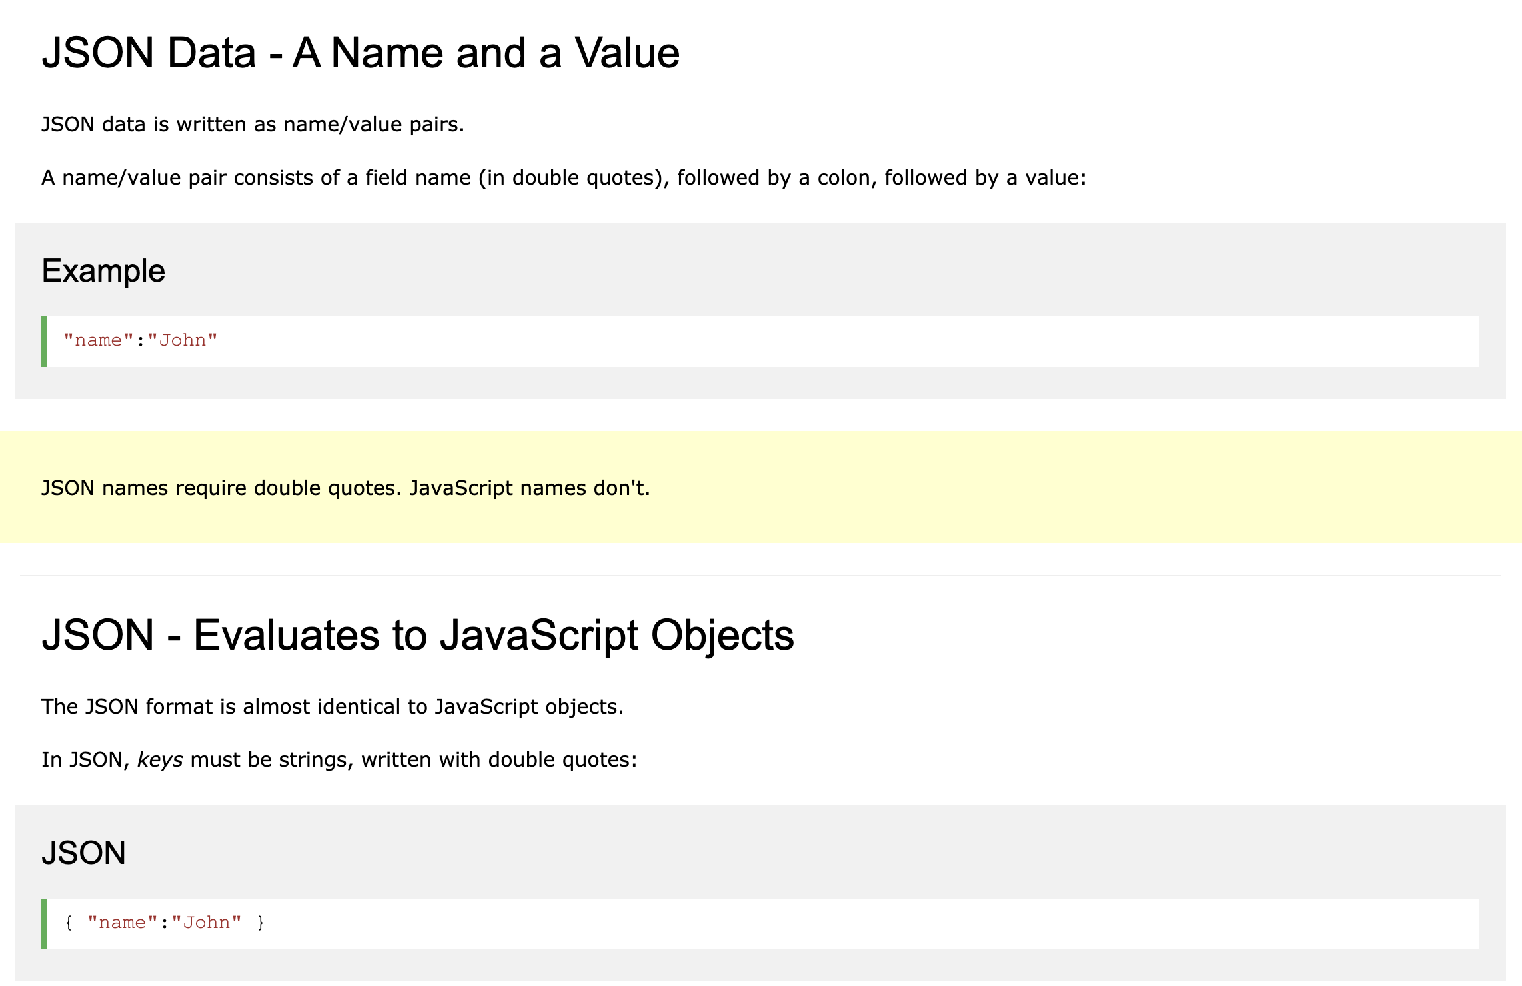
Friendly Conversation Topic

Slide 53
Test-driven Development (TDD)
Notes:
Project Plans, Tracking, Managing

Slide 54
Test-driven Development (TDD)
Test-driven development (TDD) is a software development process that relies on the repetition of a very short development cycle: requirements are turned into very specific test cases, then the code is improved so that the tests pass. This is opposed to software development that allows code to be added that is not proven to meet requirements.
American software engineer Kent Beck, who is credited with having developed or "rediscovered"^{[1]} the technique, stated in 2003 that TDD encourages simple designs and inspires confidence.^{[2]}
Test-driven development is related to the test-first programming concepts of extreme programming, begun in 1999,^{[3]} but more recently has created more general interest in its own right.^{[4]}
Programmers also apply the concept to improving and debugging legacy code developed with older techniques.^{[5]}
From Wikipedia, the free encyclopedia
Notes:
What is the term that Jeremy used for doing it in the place?

Slide 55
Software Testing Overview
Software Testing [link] is important because, if done right, it can help us find and fix problems earlier and make our system delivery process less immobile, rigid, and fragile.
As future Software Engineers , we are going to:
Understand testing within the various Software Development Lifecycles
Understand testing terminology
Know how to develop applications that are easier to test
Understand Unit Testing and Automated Testing
Notes:
Never underestimate the value of good design and implementation (for testability, encapsulation, etc.) on the economics of testing. You can’t afford to test in quality!
Developers are responsible for product quality. Tester should be able to minimize that chance that a defect makes it to production.
We test to find defects and/or to validate that we have not introduced new defects.
Defects are exponentially more expensive to fix the longer the exist.
Performance issues are often the most difficult and expensive defects to fix. They are often not found until the application if running under production load… which is often only when it is in production.
Unit - $200
Integration - $600
User Acceptance - $6,000
Production - $100,000+
The permutations of modern software features, data, tools, environments, etc. quickly becomes unmanageable. Testability needs to be goal of nearly all non-trivial applications.
Dave Cutler of Windows NT fame had a quote. I wish I could remember the exact words, but it went something like, “I hate having testers because they give developers the false hope that someone else can save them from their sins.”

Slide 56
Software Testing “Truths”
Never underestimate the value of good design and implementation (for testability, encapsulation, etc.) on the economics of testing… You can’t afford to test in quality!
Defects are exponentially more expensive to fix the longer the exist.
Unit - $200
Integration - $600
User Acceptance - $6,000
Production - $100,000+
Performance issues are often the most difficult and expensive defects to fix. They are often not found until the application if running under production load… which is often only when it is in production.
The permutations of modern software features, data, tools, environments, etc. quickly becomes unmanageable. Testability needs to be goal of nearly all non-trivial applications.

Slide 57
Software Testing “Truths” (continued)
Developers need to be responsible for product quality. Tester should be able to minimize that chance that a defect makes it to production.
Dave Cutler of Windows NT fame had a quote. I wish I could remember the exact words, but it went something like, “I hate having testers because they give developers the false hope that someone else can save them from their sins.”

Slide 58
Object-Oriented Programming within Various Development Methodologies
Notes:
Development Methodology and Software Development Lifecycle (SDLC) are often used interchangeably.
The Iterative development methodology is not depicted here as even the mainstays and inventors of the Iterative development methodology seem to be moving toward agile. Plus as Waterfall “holdouts” move, they seem to be moving directly toward Agile. Can you start to see my biases?
Development Methodologies (SDLCs) are a future Bonus Topic. There are several optional slides t the end of this deck. Let me know if you would like to have a more formal overview of the topic as part of this class. I have a passion in this area.
Object oriented-programming concepts/practices evolve and reprioritize depending on the development methodology.
For example, in Waterfall (as well as in Iterative) object-oriented design often play a critical role in the (big upfront) design activities. UML diagrams and project artifacts are often important to the overall project success. (opinion) Practical reality has been that these design artifacts often do not reflect the actual implementation and are rarely maintained or updated.
The Agile practitioners do not reject these design artifacts. However, the focus on shorter time horizons, evolving architecture, and working code changes the value proposition for object-oriented practices to more focus on the build, test, enhance activities.

Slide 60
Waterfall vs Iterative vs Agile Testing
 | Waterfall | Iterative | Agile
References | United States Department of Defense: DOD-STD-2167A (1985) | Rational Unified Process (RUP) Open Unified Process | Scrum Kanban Scaled Agile Framework (SAFe)
Priorities | Planning and predictability | Architecture, modeling, and efficiency through early detection & fixing of issues | Responsiveness to feedback, efficiency through engineering practices, early detection & fixing of issues
Principles | Execute phases sequentially: Requirements Analysis Design Coding Testing and Operations Define and commit to Scope, Cost, and Timeline “early” Implement strict Change Control | Develop and test iteratively Manage requirements Use components Model visually Verify quality Control changes | Develop, test, deploy, and release iteratively Capture lightweight near term requirements Empower teams Allow requirements to evolve but maintain fixed timelines Apply engineering practices and systems thinking (e.g. TDD) Integrate early user feedback into remaining plan Maintain a collaborative approach between all stakeholders
Notes:
The views on testing and change management have changed dramatically as organizations have moved from Waterfall to Iterative to Agile development lifecycles.
Successful Agile (and Iterative) Development REQUIRES better application design, development techniques, and testing practices.
Testing and lack of defects are not the end goal. A higher quality more usable more cost effective product is the goal.

Slide 61
Testing Terms
Important testing terms include:
Unit Testing: developer testing their own code
Integration Testing: development team testing their full code
System Testing: multiple development teams testing a full system or systems
Performance Testing: testing performance at the Unit, Integration, and/or System level
Manual Testing: a person using the application often running test scenarios
Automated Testing: a group of automated tests that run on the application in the Unit, Integration, System, or Performance testing areas
UI Automated Testing attempts to exercise the application be reproducing user events (key & mouse events)
API Automated Testing occurs at the function/method API level (JUnit for example)

Slide 62
Testing Terms
Important testing terms (continued):
Verification: does the application perform as expected
Validation: does the application provide the business benefit that was expected
Behavioral Testing: verifying that the correct functions were called with the correct parameters
State Testing: focuses on the results of those calls

Slide 63
Automated Testing
Unit testing can be done in two ways − manual testing and automated testing.
Automated testing has become a more important part of effective software testing. The pros of Automated Testing include:
Repeatable tests that are quick to run and can support Iterative and Agile development
Very effective in validating environments and doing “smoke tests” to make sure a new build meets a minimal set of requirements
Supports Performance Testing very effectively
Very inexpensive and quick to repeat testing and validate fixes
Various implications include UI, API, and Unit automation tests… each has a very different set of pros and cons
Notes:
False positives versus valid defects found.
Manual Testing and Automated Testing can be supportive of each other.

Slide 64
Automated Testing
Unit testing can be done in two ways − manual testing and automated testing.
Some of the benefits of Automated Testing have been oversold. Some of the challenges include:
Developers rarely can come up with scenarios in scripts that they would not already have tested in their normal unit testing… they often don’t know what they don’t know
UI focused Automated Testing (key & mouse events) are often challenging and create/maintain a great number of false-positives
API Level Automated Testing (i.e. REST) scripts are often more useful and easier to maintain
Environmental verification, API, and finally UI Automated testing is generally the best order to show value quickly with Automated Testing
Automated Testing investment is often not prioritized or tracked so it is difficult to know its effectiveness
Scripts can be expensive to develop and maintain
Notes:
False positives versus valid defects found.
Manual Testing and Automated Testing can be supportive of each other.

Slide 65
Automated Unit Testing Example: JUnit
Unit testing can be done in two ways − manual testing and automated testing.
JUnit [link] is a Automated Testing framework focused on developing and running Unit test for Java applications. JUnit:
Is a Java opensource extension
Provides annotations to identify test methods.
Provides assertions for testing expected results.
Provides test runners for running tests.
JUnit tests allow you to write codes faster, which increases quality.
JUnit is elegantly simple. It is less complex and takes less time.
JUnit tests can be run automatically and they check their own results and provide immediate feedback. There's no need to manually comb through a report of test results
Notes:
@Test
identifies the method as a test method (remember, method and function are synonyms)
@Test(expected = Exception.class)
fails if the method does not throw the named exception
@Test(timeout=100)
fails if the method takes longer than 100 milliseconds
@Before
public void method()
This method is executed before each test. It is used to prepare the test environment.
@After
public void method()
This method is executed after each test. It is used to clean up the test environment, including cleaning up expensive memory structures.
@BeforeClass
public static void method()
This method is executed once, before any test is done. It is used to do time-intensive tasks before any test is done.

Slide 66
Final Thoughts: Test-driven Development (TDD)
Notes:
Project Plans, Tracking, Managing

Slide 67
Models

Slide 68
Hosting Technology: Cloud & Software as a Service (SaaS)…
People: Organizations, Domain Knowledge, Customers, Business Process…
The
Virtuous Triangle
Process: Agile, Requirements, Project Management, Prioritization, Portfolio Management, Metrics…
Productivity Technology: Configuration Management, Source Code Management, Automated Testing…

Slide 69
The Righteous Triangle of Software Development
People & Organizations
Technology & Tools
Process & Roles

Slide 70
Waterfall vs Iterative vs Agile Requirements
 | Waterfall | Iterative | Agile
References | United States Department of Defense: DOD-STD-2167A (1985) | Rational Unified Process (RUP) Open Unified Process | Scrum Kanban Scaled Agile Framework (SAFe)
Priorities | Planning and predictability | Architecture, modeling, and efficiency through early detection & fixing of issues (verification) | Responsiveness to feedback, efficiency through engineering practices, early detection & fixing of issues, and validation
Principles | Execute phases sequentially: Requirements Analysis Design Coding Testing and Operations Define and commit to Scope, Cost, and Timeline “early” Implement strict Change Control | Manage requirements Develop and test iteratively Use components Model visually Verify quality Control changes | Capture lightweight near term requirements Allow requirements to evolve but maintain fixed timelines Develop, test, deploy, and release iteratively Empower teams Apply engineering practices and systems thinking Integrate early user feedback into remaining plan Maintain a collaborative approach between all stakeholders
Notes:
The views on testing and change management have changed dramatically as organizations have moved from Waterfall to Iterative to Agile development lifecycles.
Successful Agile (and Iterative) Development REQUIRES better application design, development techniques, and testing practices.
Testing and lack of defects are not the end goal. A higher quality more usable more cost-effective product is the goal.
Requirements:
Waterfall:
Full project requirements upfront
Inconsistent industry capture techniques
Tend to be verbose requirements with formal signoff
Change requests needed
Estimation bottom up detailed estimates sometimes function points
Iterative:
Mostly upfront

Slide 71
Requirements – Waterfall
When working in a Waterfall SDLC Requirements are generally:
Captured up front (before any design or development)
Documented in a variety of formats
Verbose
Estimated in detail using bottom-up estimating techniques (sometime Function Points)
Risk Analysis & Mitigation
Signed off on
Managed with change requests
Notes:
Grace period until Monday morning a 6am CT

Slide 72
Requirements – Iterative (RUP)
When working in an Iterative (RUP) SDLC Requirements are generally:
Captured primarily up front but updated during design
Documented in Use Cases
Moderately verbose
Estimated using Use Case points
Signed off on with an understanding that minor changes are likely
Managed with change requests
Notes:
Grace period until Monday morning a 6am CT

Slide 73
Requirements – Agile (Scrum)
When working in an Agile (Scrum) SDLC Requirements are generally:
Captured before each sprint
Documented using Stories (light weight)
In Scaled Agile Epics & Features are also used
Only detailed as needed
Estimated using Story Points (very light weight)
Immutable for current sprint
Change is encouraged for future sprints
Notes:
Final Topics:
SMART: Specific, Measurable, Achievable, Relevant, and Time-boxed
Be very careful attempting to measure productivity across teams
Story Points vs Use Case Points vs Function Points

